Slide 1
Case Study - Gentech
Team members:
Reshini Suresh Kumar
Riya Agarwal
Kalpesh Balkrushna Patil
Balbir Singh

Slide 2



Introduction
Gentech is a large multinational company with an annual revenue of $60 Billion.
Problem Statement: Gentech has seen an 18% reduction in its revenue.
What to do? Analyze the reasons and find the efficient solution
How? DMAIC approach

Slide 3

VOICE OF CUSTOMER
In order to remain competitive and satisfy customer expectations, Gentech's Voice of the Customer (VoC) highlights the necessity of clear, precise communication and quicker, dependable proposal cycle times.
Internal stakeholders look to the Bid Support Specialists for effectiveness, less administrative work, and reliable assistance.

Slide 4
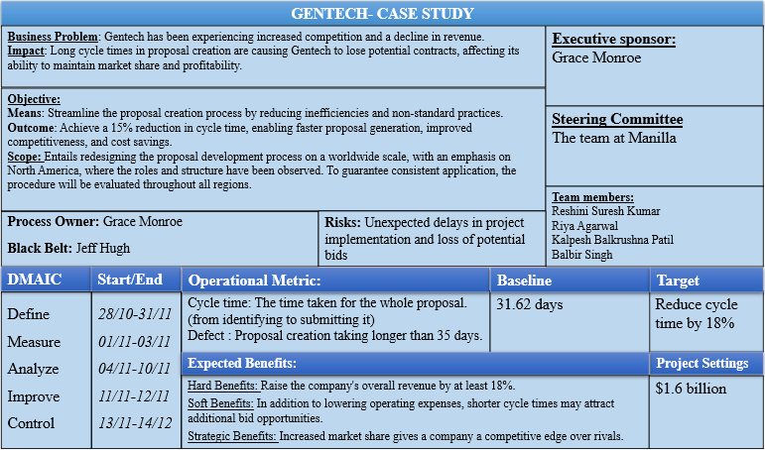
Project Charter

Slide 5
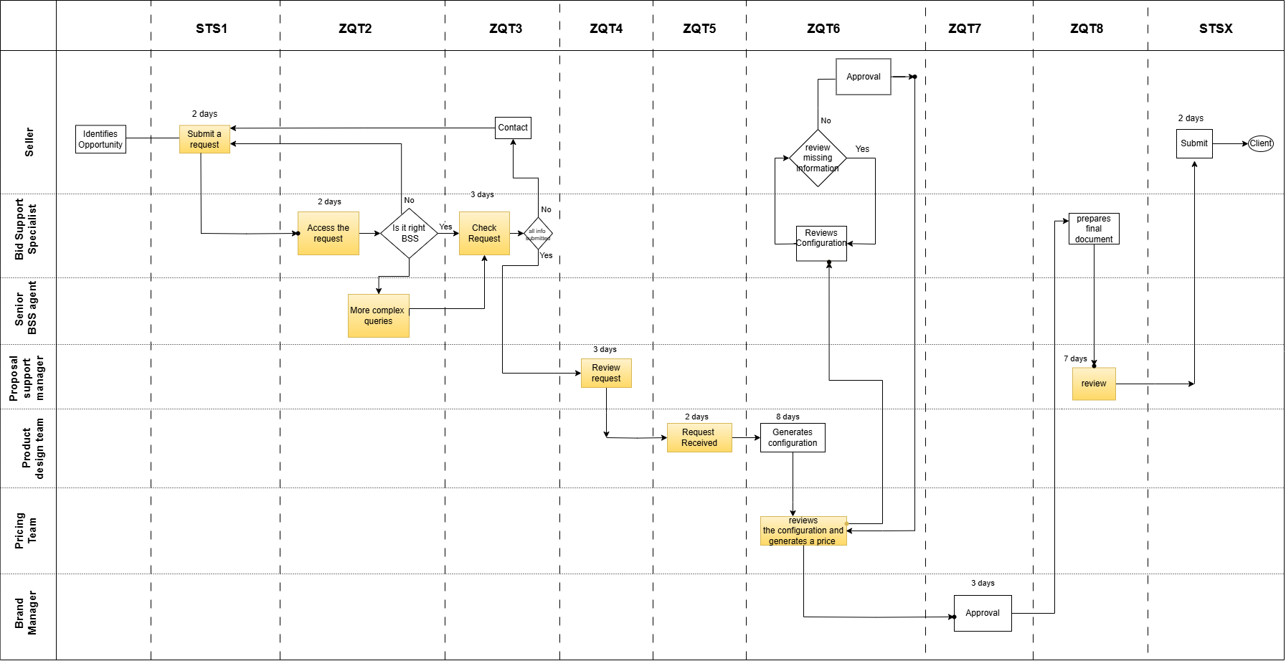
Process Map

Slide 6

DPMO
Total Defects: 21,079 transactions exceeded the 35-day SLA
Calculation :
Substituting the values in the DPMO formula: DPMO = $\frac{Total defects}{Total Opportunities}∗1000000$
DPMO = $\frac{21079}{75000}∗1000000 =281053.33$ Sigma level = Norm.S.Inv(1-(DPMO/1000000)) + Process SHIFT (off-centering) Assuming 1.5 process shift,
Sigma Level = 0.579715 +1.5 = 2.08
For a DPMO of around 281,000, the Sigma level is approximately 2.
2 sigma level indicates that Gentech is not operating at the desired level and existing processes need to be analyzed and improved to decrease the defects, thereby increasing performance and revenue.

Slide 7
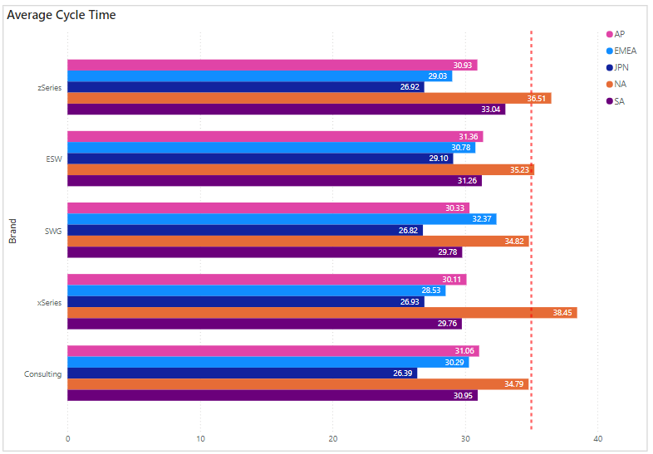
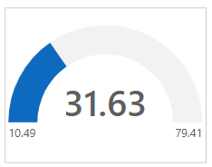
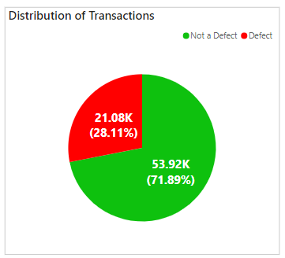
AVERAGE CYCLE TIME

Slide 8
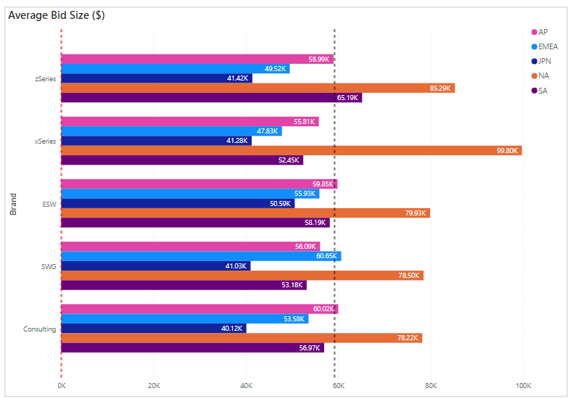
BID SIZE

Slide 9
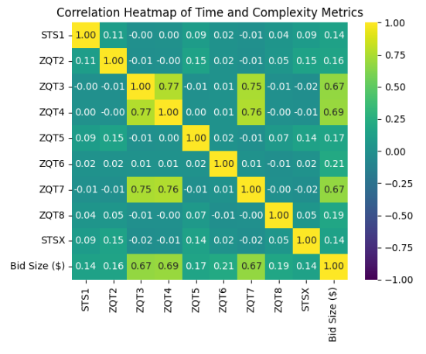
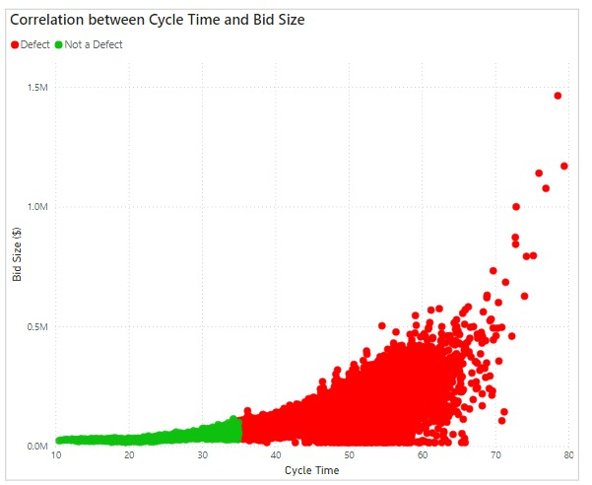
CYCLE TIME AND BID COMPLEXITY

Slide 10
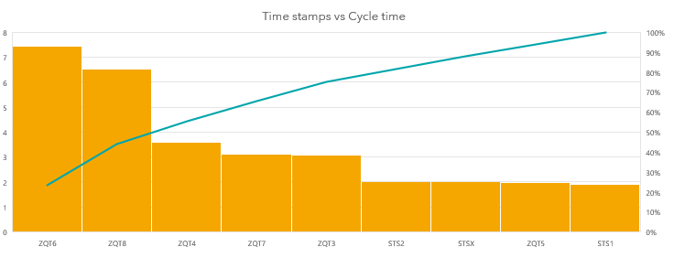
ZQT6 and ZQT8 – Major concerns

Slide 11
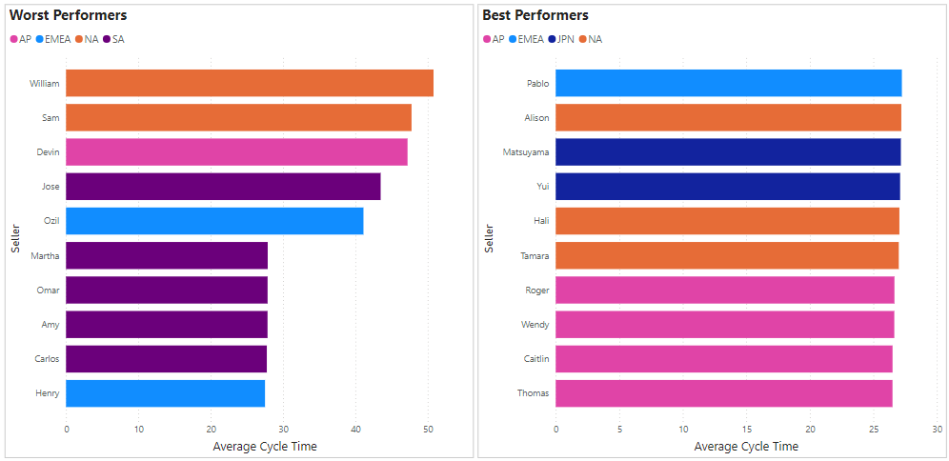
SELLER PERFORMANCE

Slide 12
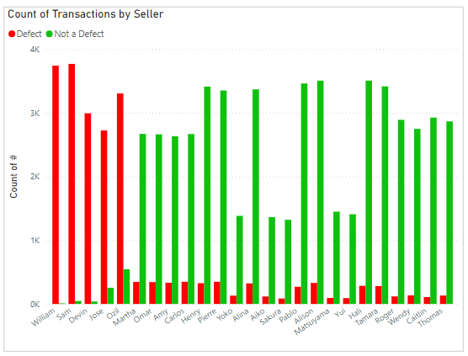
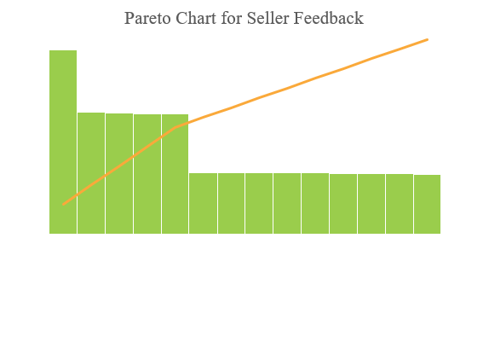
Seller Analysis

Slide 13
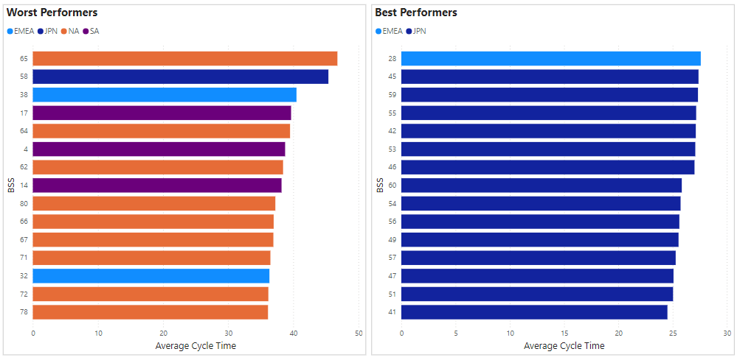
BSS PERFORMANCE

Slide 14
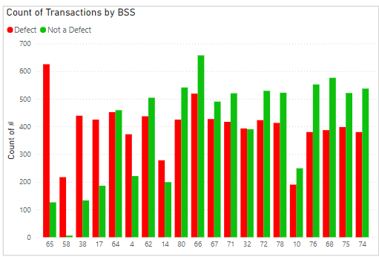
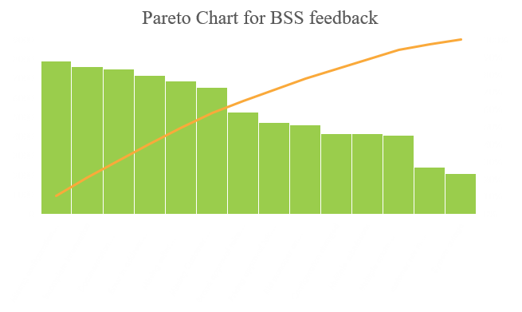
BSS Analysis

Slide 15
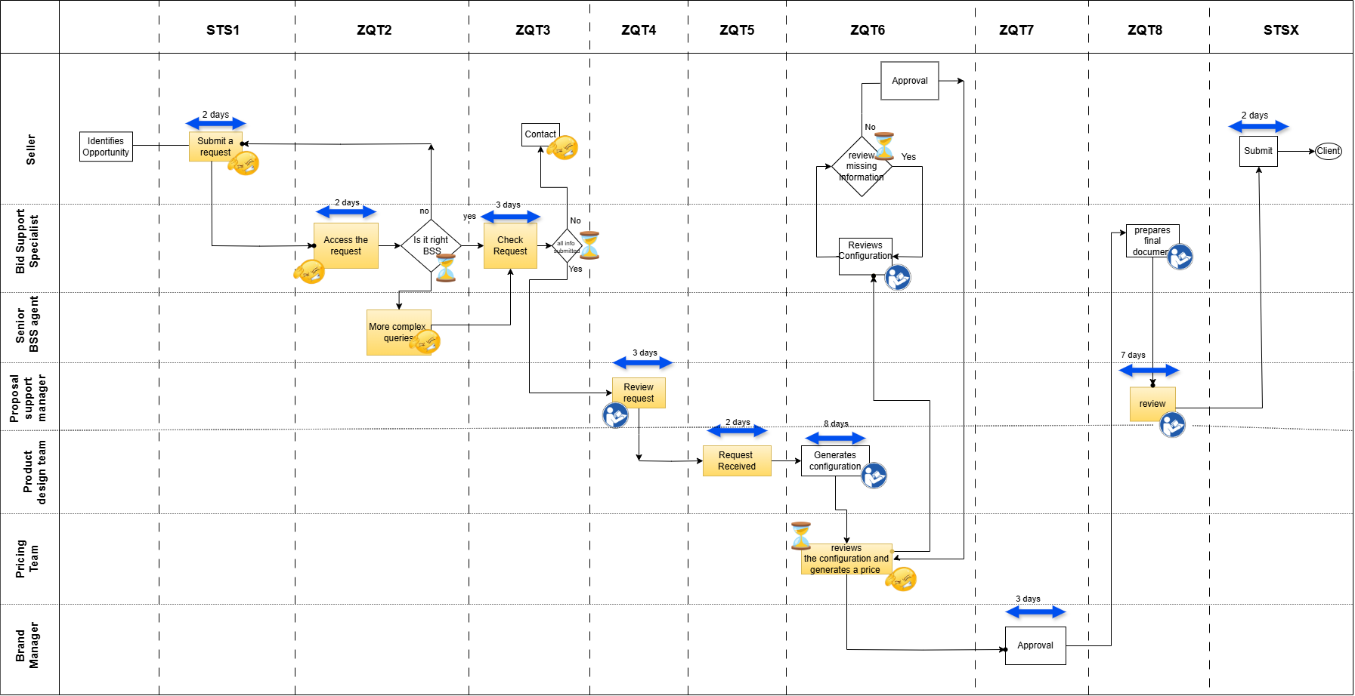



Pain Points
Long wait times
Manual intervention

Slide 16
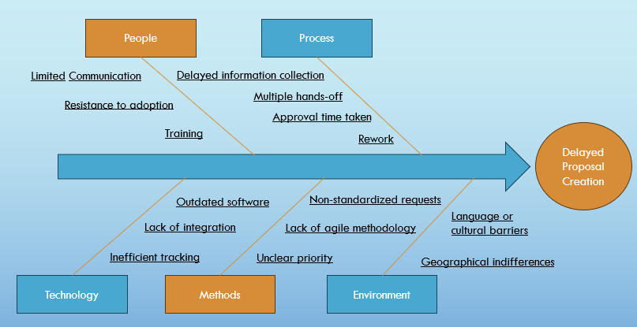
FISH BONE DIAGRAM

Slide 17
IMPROVEMENTS
Work on improving top feedback received from BSS - Missing configuration details, Incomplete information - implement Poka Yoke Technique by indicating asterisk for necessary config details and info.
Work on improving top feedback received from Seller - Difficult to identify BSS agent (have proper documentation to identify BSS), Incorrect configuration, BSS lacks domain knowledge(provide regular training), Proposal takes too long, BSS inexperienced(provide comprehensive training).
Reducing average time taken for ZTQ6 from 8 days to 5 days and for ZTQ8 from 7 days to 5 days – by streamlining approval process and Proposal Manager will review only large size bids, smaller bids do not require review.
Average Cycle Time reduction by 18% from 32 days to 26 days.
Increase in revenue by $1.6 billion – Can be achieved by reducing cycle time by 18%

Slide 18
CONTROL MEASURES AND RECOMMENDATIONS
Establish KPIs (e.g., target cycle times, process efficiency) to set performance benchmarks.
Utilize control charts (e.g., Xbar-R charts) to monitor the stability and variability of the proposal creation process.
Standardize processes through updated documentation, training, and clear communication of roles.
Implement a feedback loop to capture insights and continuous feedback from sellers and BSS.
Set Clear Service Level Agreements (SLAs) based on proposal complexity to manage expectations.
Incentivize SLA Adherence and recognize and reward team members who consistently meet or exceed performance targets.

Slide 19
THANK YOU !

